Slide 1
Industry Project – Grow box
Group 3

Slide 2
Final Achievements
Successful network established
Shared water tank
Node-red dashboard

Slide 3
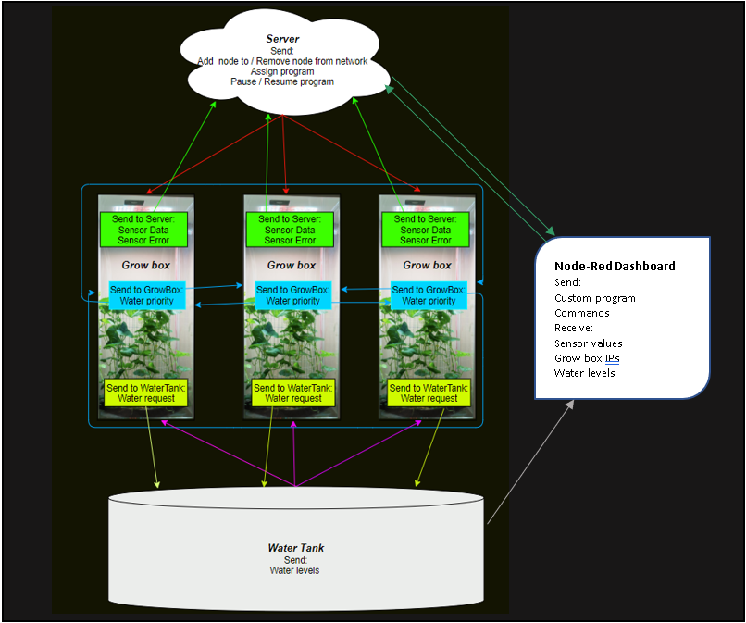
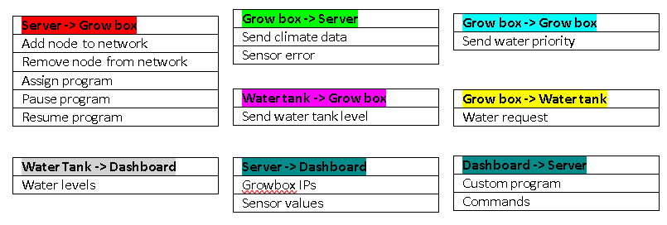
Context Diagram

Slide 4
Issues encountered
Not checking ACK messages for every message
Missing physical prototype
Missing pre-made crop programs (Ex: Tomato…)
Disconnecting Grow box

Slide 5
Performance aspects
Quality of design and code
Mostly focused on happy flow
Initial class diagram did not match final product
Code takes a lot of memory
Messages are being sent faster than needed to avoid them being missed

Slide 6
Evaluation process
What went wrong?
Promised more than delivered
physical prototype
What went well?
Have a working network
simulated nodes
Effort and time spent?
Every member of the group had individual tasks
Everything was integrated at the end
Quality check?
Stress test

Slide 7
Demo
Grow-box with server, water tank, and dashboard
Two Grow-boxes with server, water tank, and dashboard
Shared water priority (Distributed Systems)

Slide 8
Questions?

